Slide 1
Familiarize yourself with phishing attacks
<Hr and Marketing>

Slide 2
What is phishing?
Phishing: an avenue for a malicious external (sometimes internal) attacker to breach the company with methods such as Emails, Messages and phonecalls

Slide 3
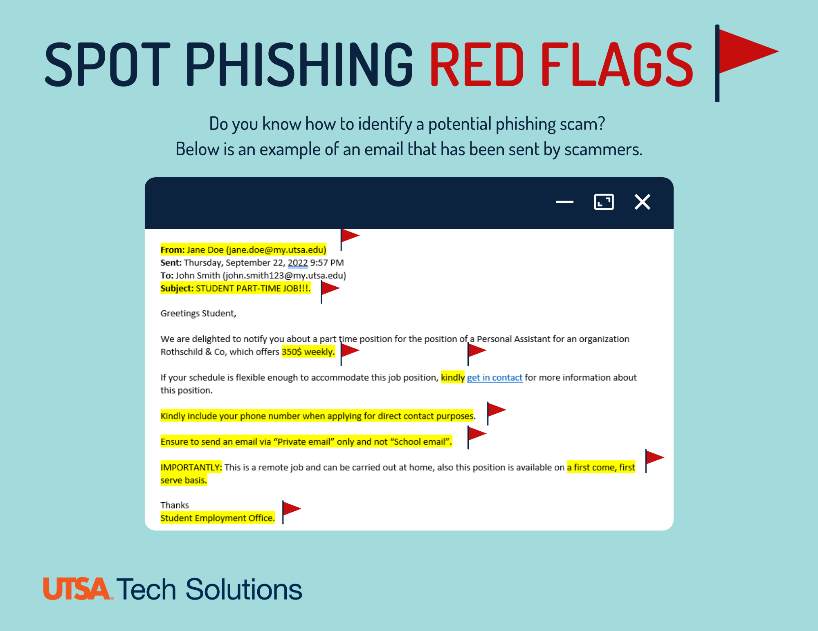
Learn to spot phishing emails
Here are some examples of very obvious Phishing emails take note of the highlighted sections:

Slide 4
How do we stop getting phished?
Examine Subject for unneccesary urgency.
Examine links to external sites
Beware requests for sensitive data over phone calls
Threat actors (Malicious people) could be impersonating managerial positions so communicate with know associates before proceeding.
Contact IT department if worried.

